Slide 1
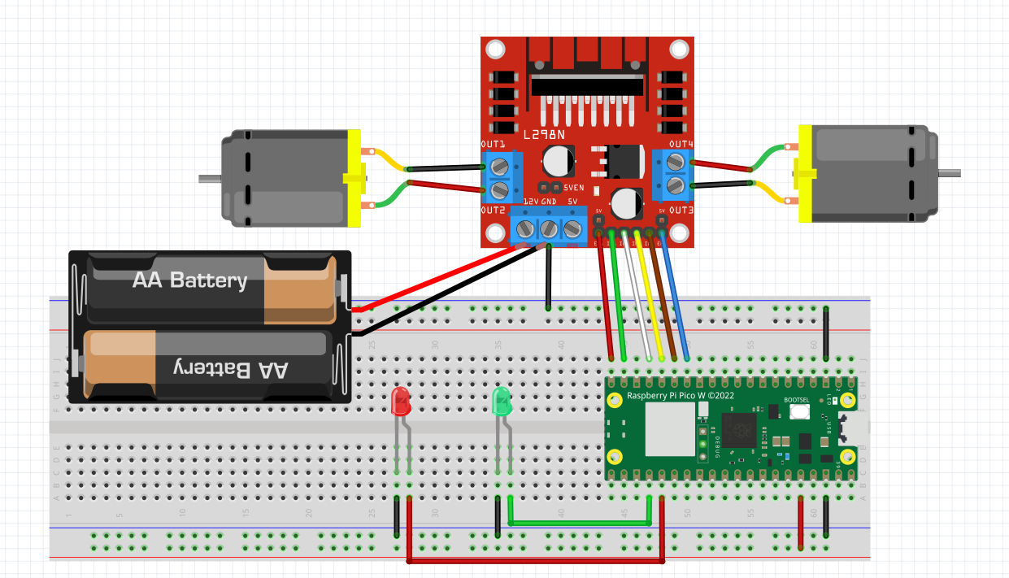
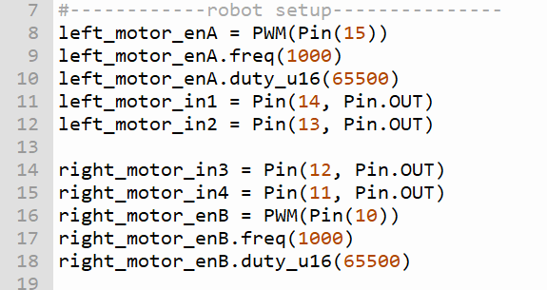
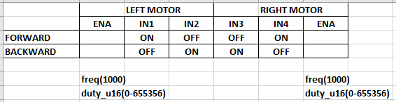
WIRING DIAGRAM OF TEST ROBOT
ROBOT ORIENTATION
LEFT MOTOR
RIGHT MOTOR
Follow the wire colour in this diagram
15 14 13 12 11 10
ENB

